Slide 1

Characterization techniques applied to Carbon Nanowires
Team 3
Angel Manuel Villalba Rodríguez <A00828035@itesm.mx>
Constanza Alvarez López <A00829469@itesm.mx>
Antonio Osamu Katagiri Tanaka <A01212611@itesm.mx>
Tuesday, 24 November 2020

Slide 2
Agenda
Project Overview, goals & justification : <2min
Characterization Techniques : ~10min
Rheology
Scanning Electron Microscopy (SEM)
Raman Spectroscopy
4-Wire Kelvin
Conclusions : <1min
Q&A : <4min

Slide 3
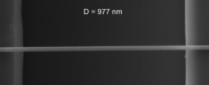
Justification:
CNWs’ Applications
Sensors
Electronic & Optical Devices
Energy Generation & Storage
CNWs morphology & conductivity
J. Jang, J. Bae, Carbon nanofiber/polypyrrole nanocable as toxic gas sensor, Sensors Actuators B Chem. 122 (2007) 7–13. https://doi.org/10.1016/j.snb.2006.05.002.
X. Shi, W. Zhou, D. Ma, Q. Ma, D. Bridges, Y. Ma, A. Hu, Electrospinning of Nanofibers and Their Applications for Energy Devices, J. Nanomater. 2015 (2015) 1–20. https://doi.org/10.1155/2015/140716.
C. Monterrey, B. Cárdenas Benítez, INSTITUTO TECNOLOGICO Y DE ESTUDIOS SUPERIORES DE MONTERREY Advanced Manufacturing Techniques for the Fabrication and Surface Modification of Carbon Nanowires, (2017) 160.

Slide 4
Introduction: Project Overview
To design polymer solutions that can be electrospun by NFES, photopolymerized, and then pyrolyzed into conductive carbon nano-wires.
Near-Field Electrospinning & Photopolymerization
Polymeric micro-fibers
Pyrolysis and Carbonization
Carbon nano-fibers
4-Wire Kelvin
Raman Spec.
SEM
Polymer Solution
SEM
Rheology
Fabrication Process
Product
Characterization Technique
Notes:
The following shows the overall process for the fabrication of carbon nanowires. The first step is to design a polymer solution with the right rheological properties such that the electrospinning process can be successfully performed. The electrospinning will be implemented to transform the solution into polymeric fibers and then into carbon nanowires through a pyrolysis process. Microscopy analyses will be performed before and after pyrolysis to capture any changes in morphology. The final product will undergo Raman and electrical conductivity measurements to determine if the proposed polymer solution improves the carbon structure properties of thinner diameter and increased conductivity.

Slide 5

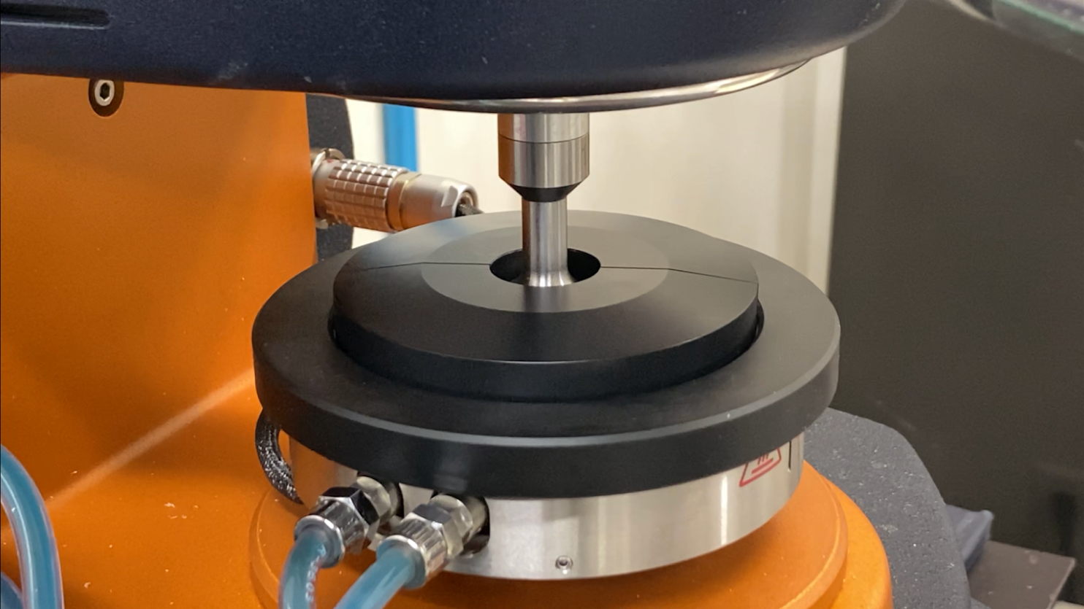
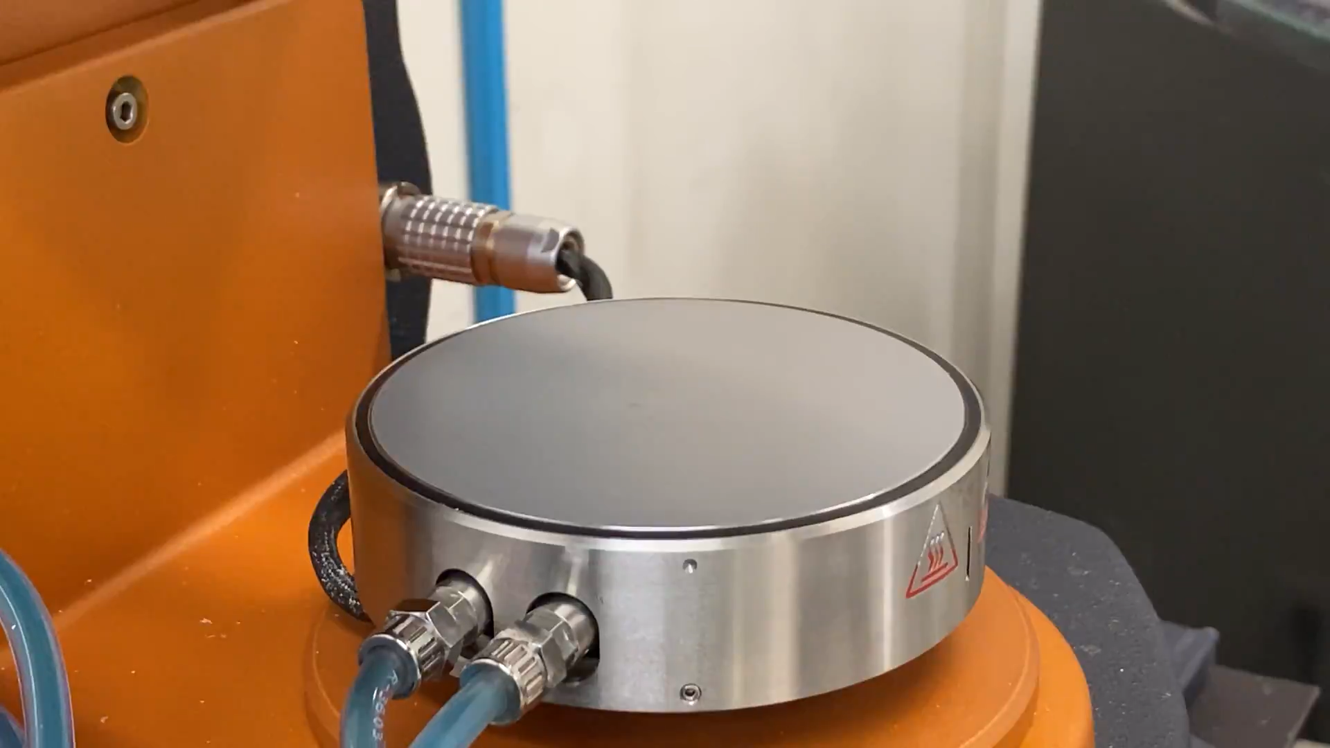
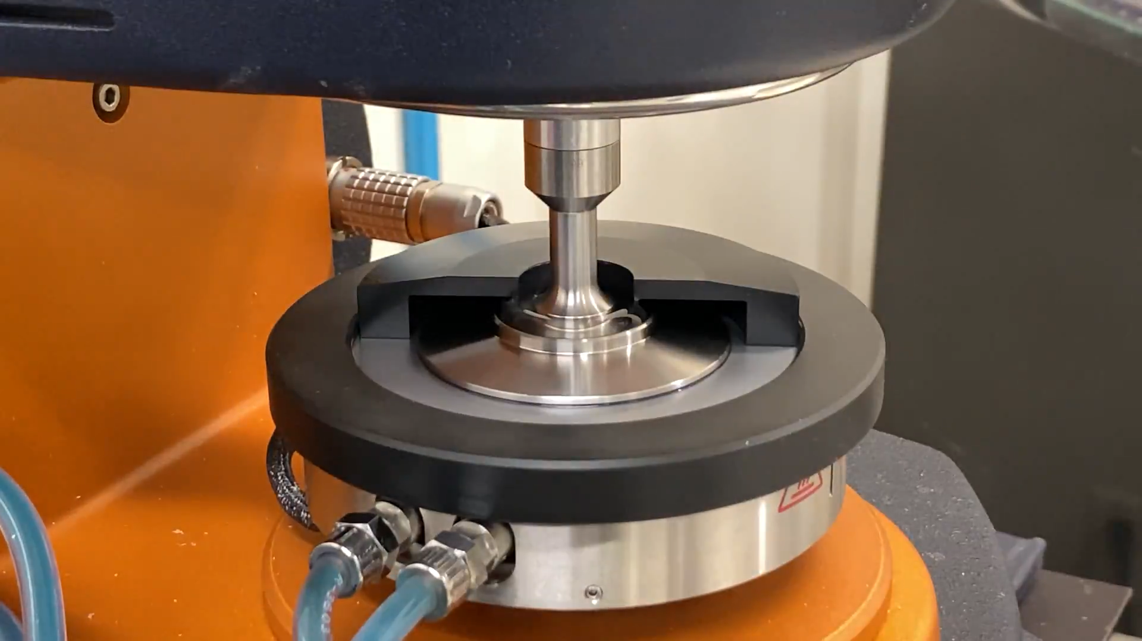
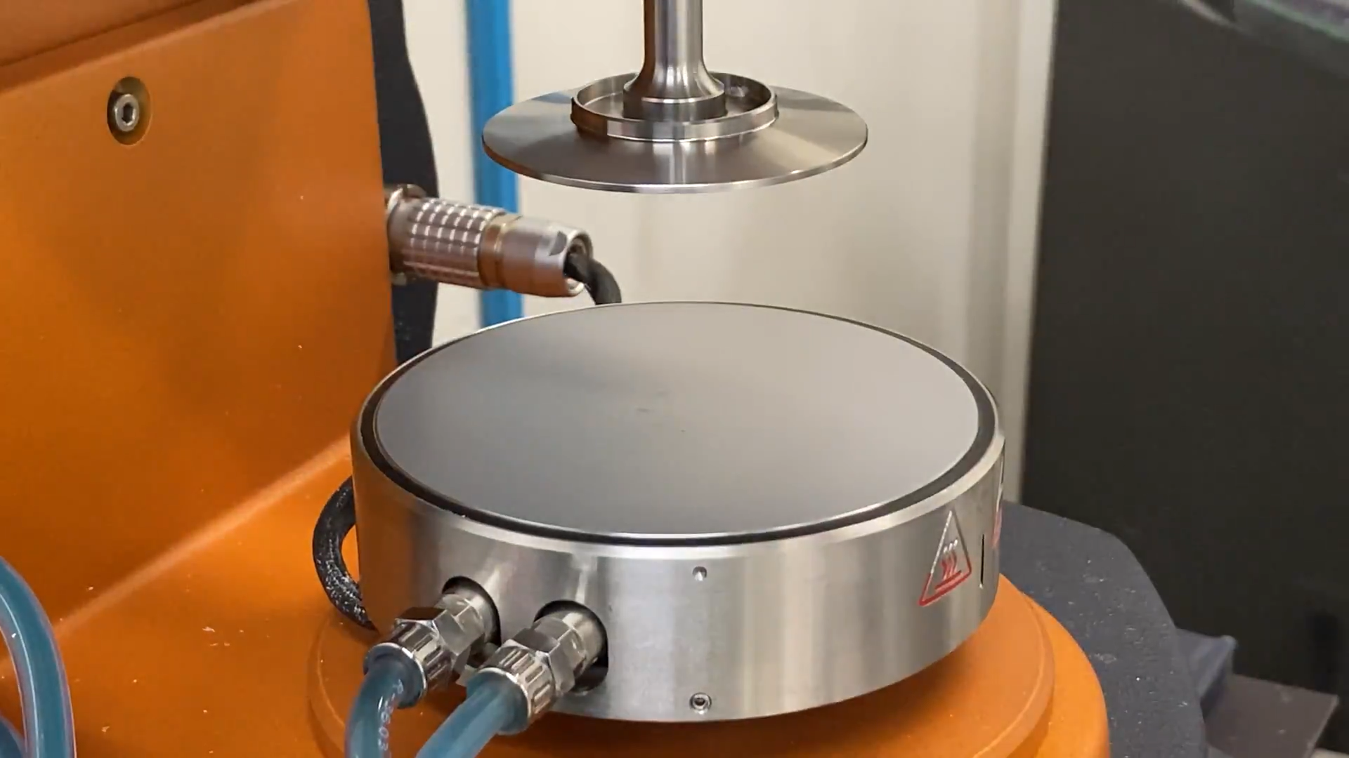
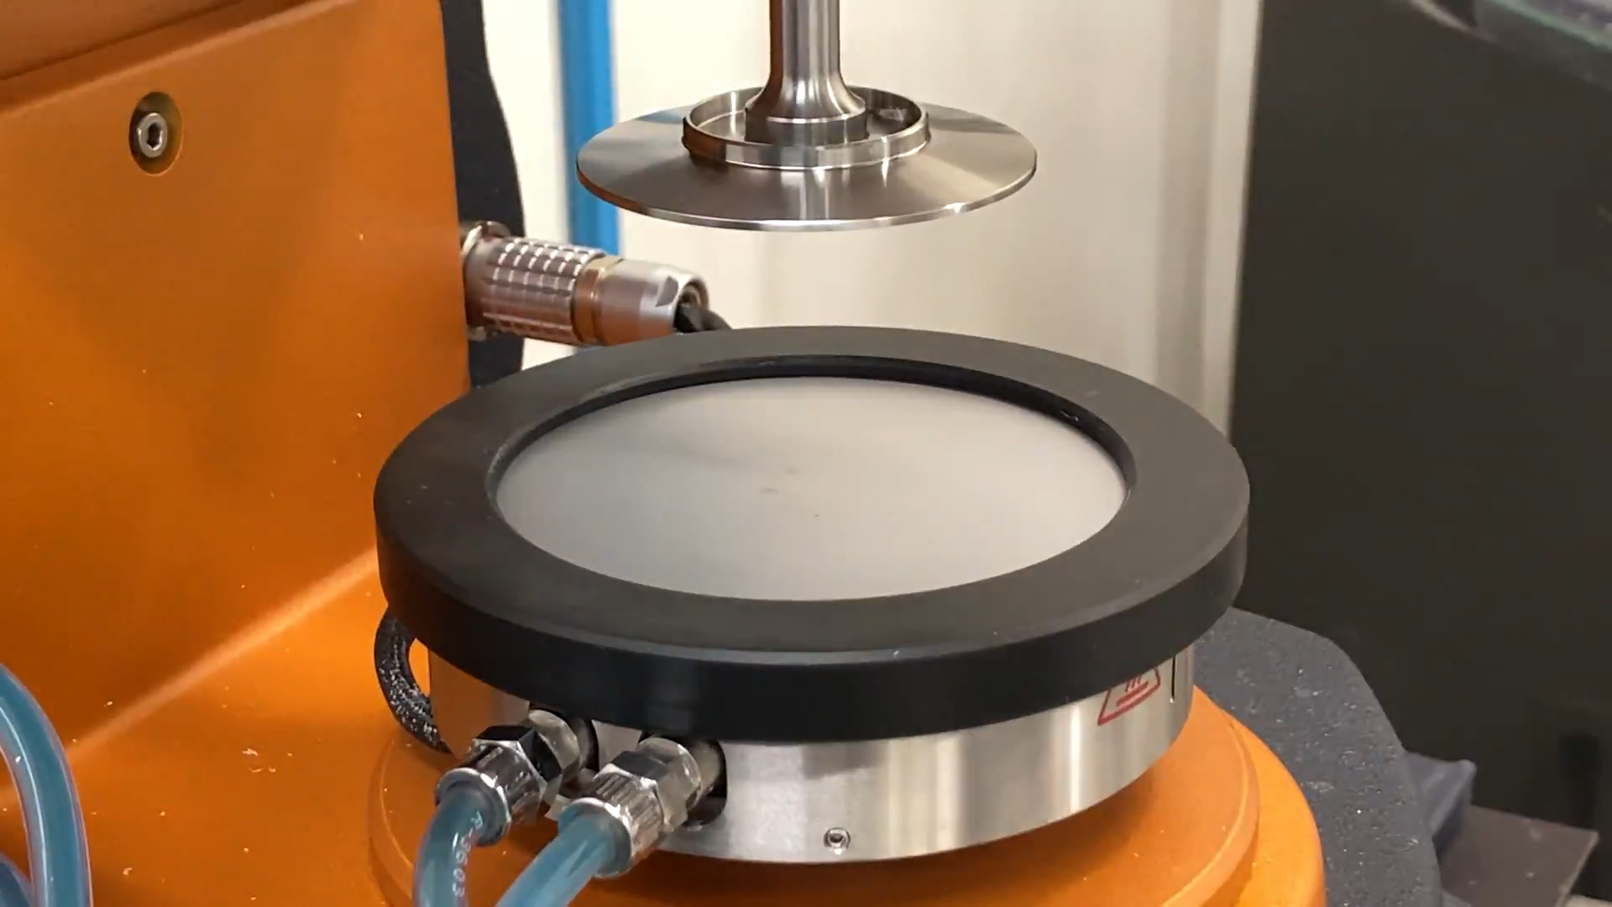
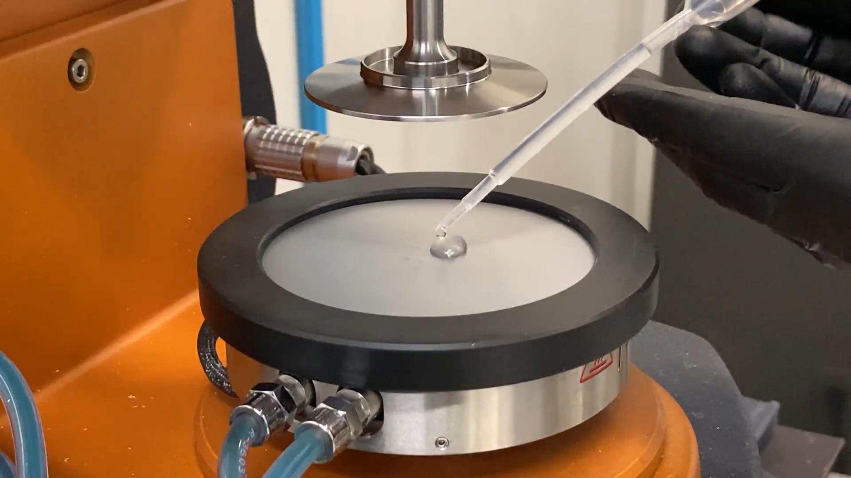
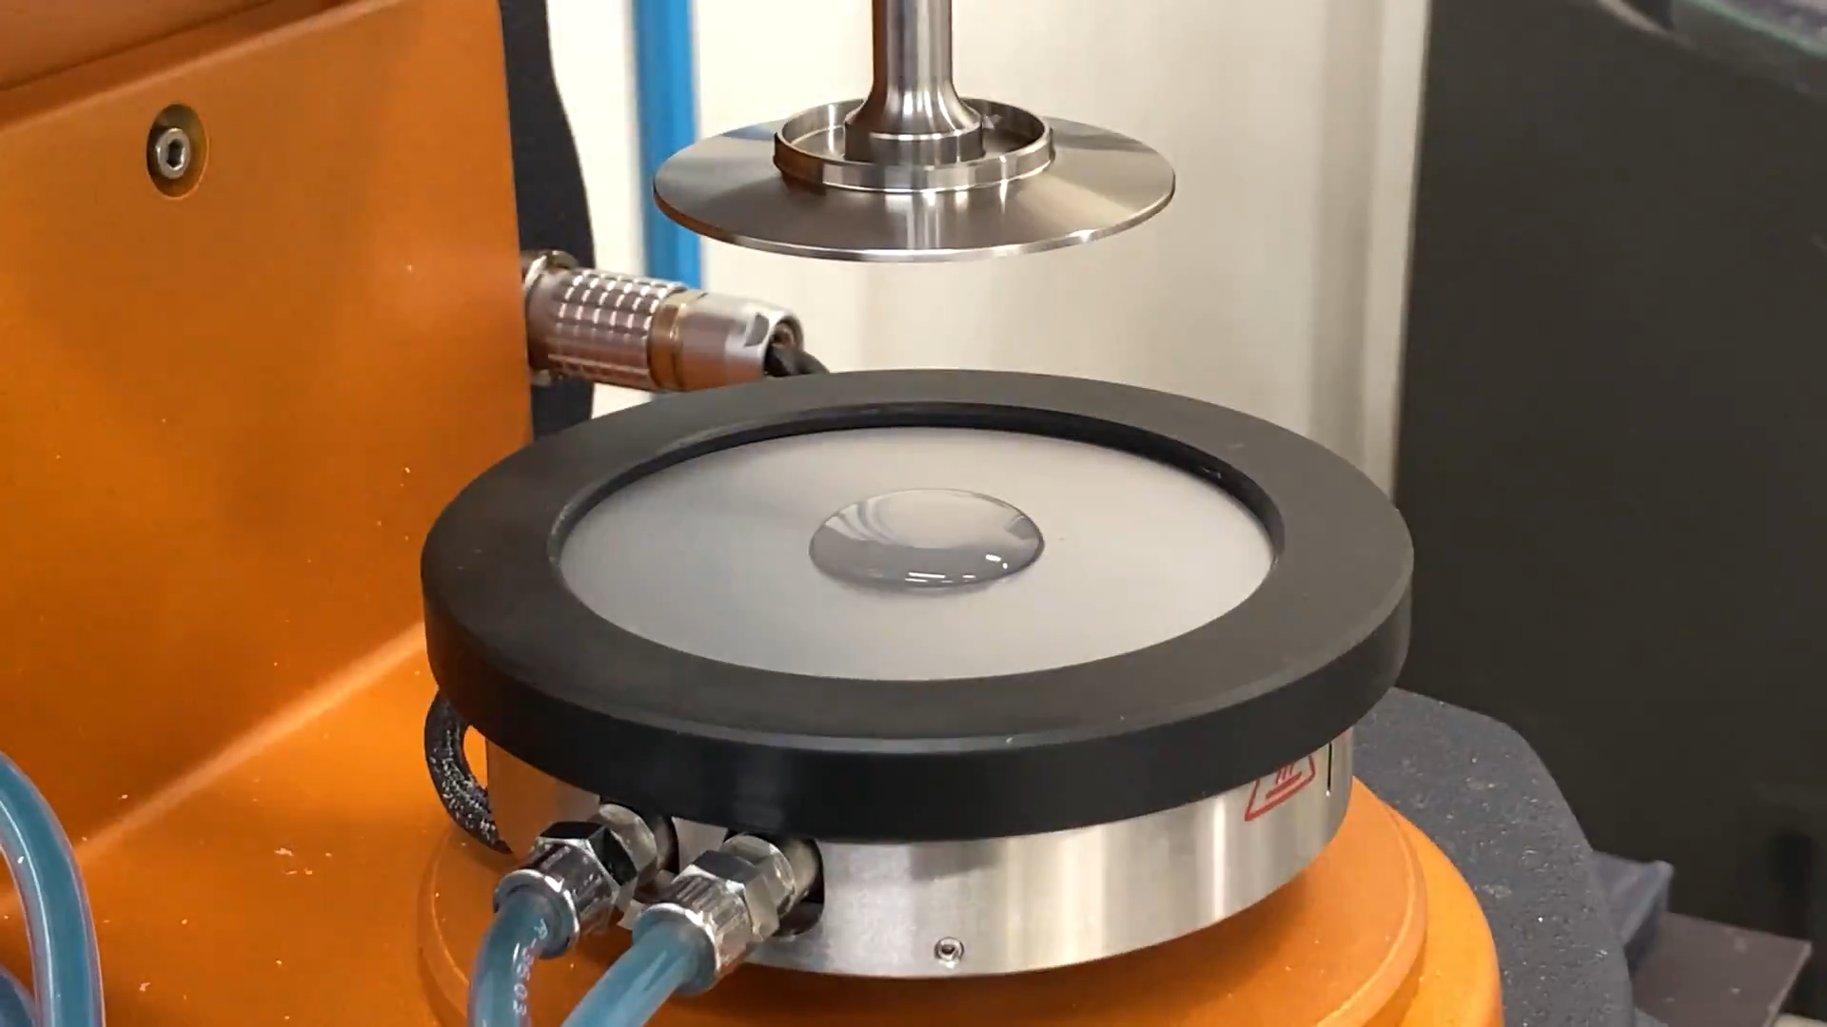
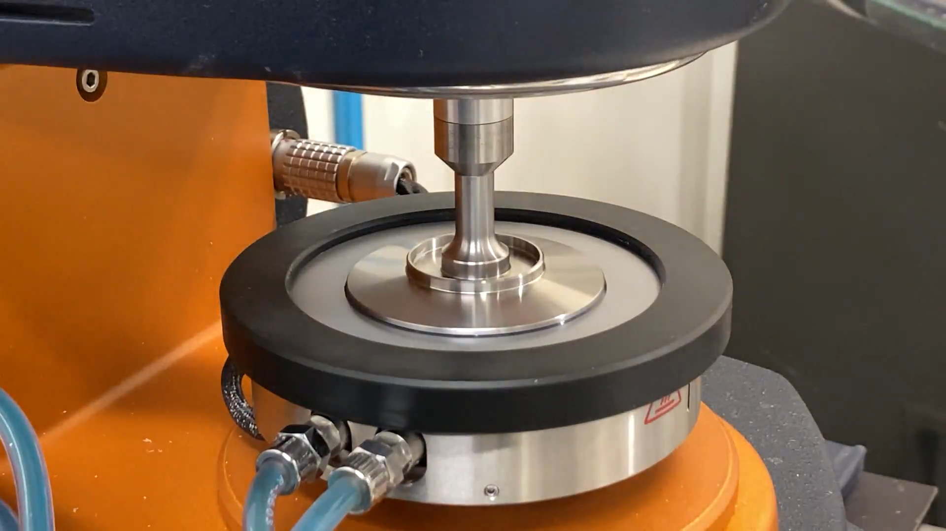
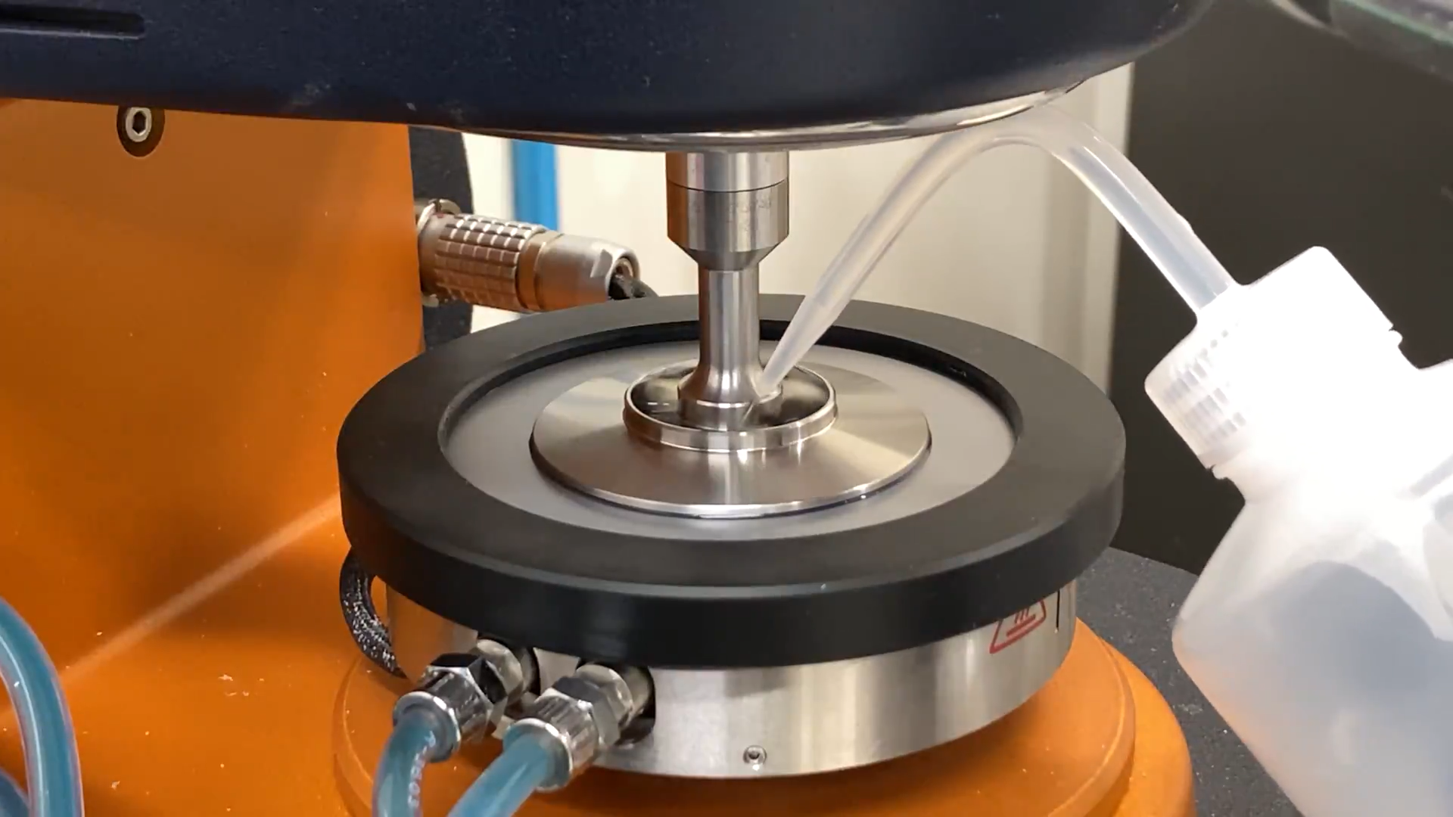
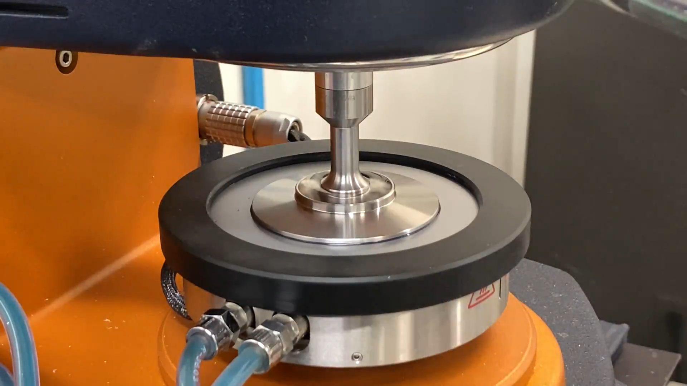
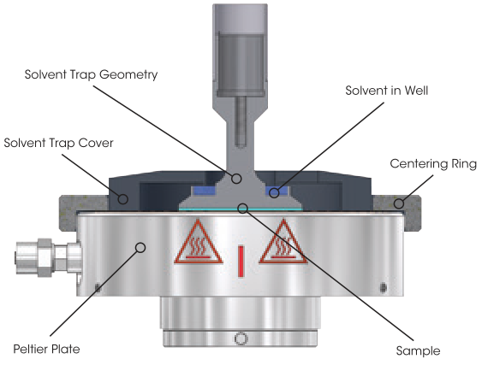

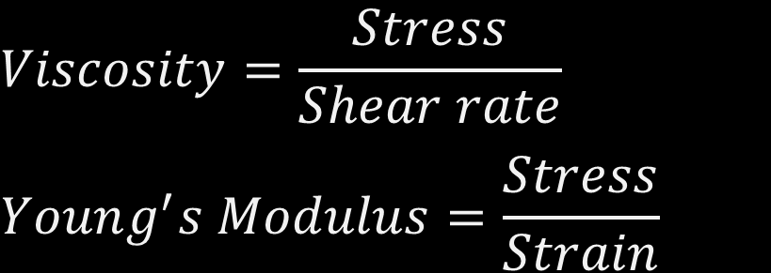
Charc. Techniques: Rheology (instrumentation)
Measured Parameter | Calculated Parameter
Torque Angular displacement Angular velocity | Stress Strain Shear rate
$$Stress=Torque\left[N∙m\right]∙Stress constant$$
$$Strain=Angular displacement\left[rad\right]∙Strain constant$$
$$Shear rate=Angular velocity\left[\frac{rad}{s}\right]∙Strain constant$$
$$Viscosity=\frac{Stress}{Shear rate}$$
$$Young^{′}s Modulus=\frac{Stress}{Strain}$$
Discovery Hybrid Rheometers – TA Instruments, (n.d.). https://www.tainstruments.com/products/rheology/discovery-hybrid-rheometers/ (accessed 18 May 2020).
Malvern Instruments Worldwide, Malvern Instruments White Paper - A Basic Introduction to Rheology Shear Flow, (2016) 1–20. https://www.malvernpanalytical.com/en/learn/knowledge-center/whitepapers/WP160620BasicIntroRheology.html.
Notes:
•Torque is a measure of how much a force acting on an object causes that object to rotate
•Shear stress is calculated from the torque and geometry stress constant
---
•Angular displacement is the angle, in radians, through which an object moves on a circular path
•Strain is a measure of deformation representing the angular displacement relative to a reference length
---
•Angular velocity is the change in angular displacement per unit time of measurement
•Shear rate is calculated from the angular velocity and geometry strain constant
---
Constants are geometry type and sample size dependent.
---
•The Modulus tells how much a material will deform elastically when you apply a certain amount of stress
•Viscosity tells how fast the material will flow

Slide 6
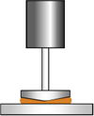
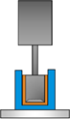
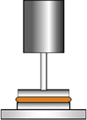
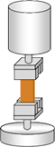
Charc. Techniques: Rheology (process parameters)
Important rheometer parameters:
Torque Range
Angular Resolution
Angular Velocity Range
Frequency Range
Geometry options:
Concentric Cylinders
Cone and Plate
Parallel Plate
Torsion Rectangular
Very Low Viscosity
Solids
Discovery Hybrid Rheometers – TA Instruments, (n.d.). https://www.tainstruments.com/products/rheology/discovery-hybrid-rheometers/ (accessed 18 May 2020).
Notes:
•In general, lower viscosity use larger diameter or larger contact area and higher viscosity or more solid-like smaller diameter
* Concentric you need more sample

Slide 7
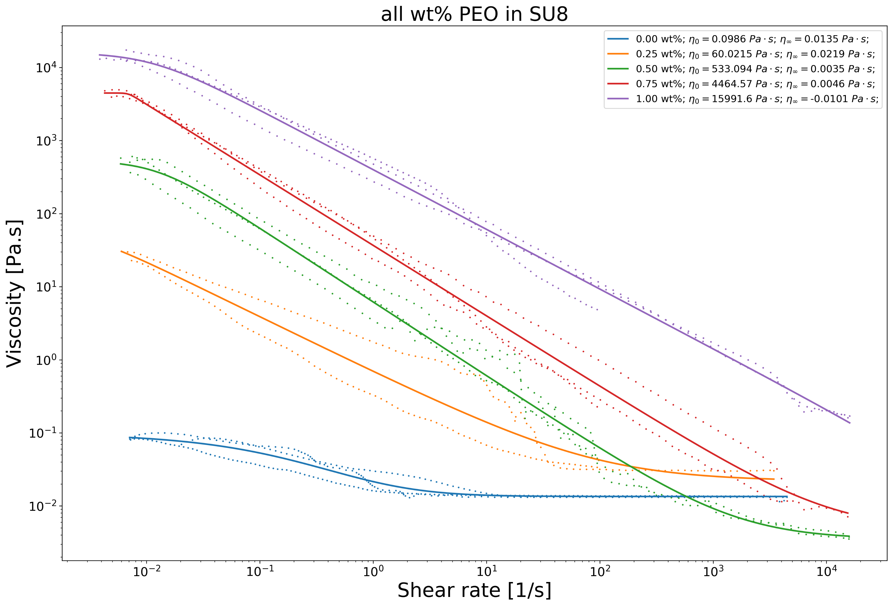
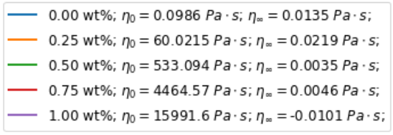
Charc. Techniques: Rheometry (Example results)
Notes:
Zero shear and infinite shear viscosities of 5 PEO and SU-8 solutions at different concentrations.

Slide 8
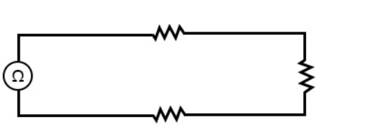
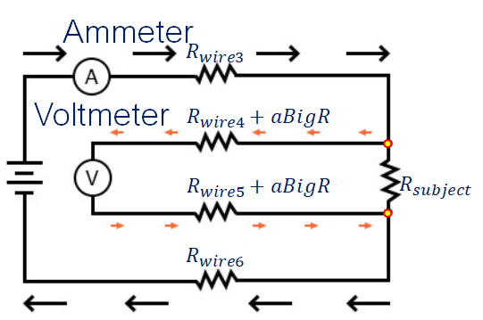
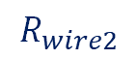
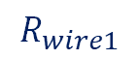
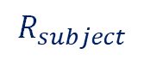

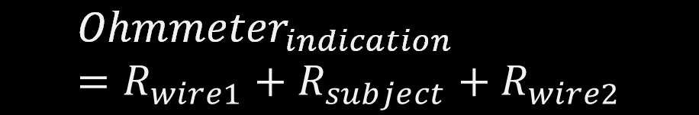

Charc. Techniques: 4-Wire Kelvin
Typical method:
Kelvin method:
$$R_{wire1}$$
Ohmmeter
$$R_{subject}$$
$$R_{wire2}$$
$${Ohmmeter}_{indication}=R_{wire1}+R_{subject}+R_{wire2}$$
If the sample has a very low resistance, the measurement error introduced by wire resistance will be substantial.
$$R_{subject}=\frac{{Voltmeter}_{indication}}{{Ammeter}_{indication}}$$
Electrical conductivity:
$$σ=\frac{L}{R_{subject}∙A} \left[\frac{S}{m}\right]$$
Keithley Instruments Inc, Series 2600B System SourceMeter ® Instrument Reference Manual, (2019) 1–946.
Notes:
Typical method:
Usually, wire resistance is very small (only a few ohms per hundreds of feet, depending primarily on the gauge (size) of the wire), but if the connecting wires are very long, and/or the component to be measured has a very low resistance anyway, the measurement error introduced by wire resistance will be substantial.
An ingenious method of measuring the subject resistance in a situation like this involves the use of both an ammeter and a voltmeter.
Kelvin method:
It appears that we have lost any advantage of measuring resistance this way, because the voltmeter now has to measure voltage through a long pair of (resistive) wires, introducing stray resistance.
However, upon closer inspection it is seen that nothing is lost at all, because the voltmeter’s wires carry miniscule current.

Slide 9
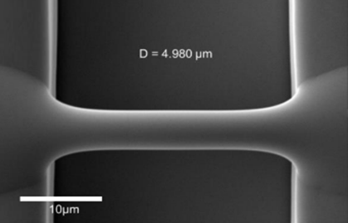
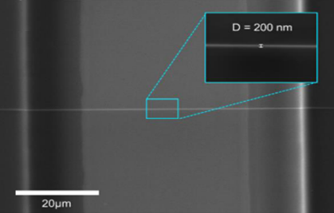
Charc. Techniques: Scanning Electron Microscopy (SEM)
A beam of electrons scans across the material surface, producing high-energy back-scattered electrons and low-energy secondary electrons. The back-scattered electrons provides a physical image of the sample surface.
Sample preparation:
After assesing conductivity of carbon nanowires, metal coating is only applied when they don’t present conductivity
Fiber diameter before pyrolysis
Fiber diameter after pyrolysis
B. Cárdenas, Advanced Manufacturing Techniques for the Fabrication and Surface Modification of Carbon Nanowires, (2017) 160.
Notes:
Porosity,
Surface distribution, and
Fiber morphology

Slide 10
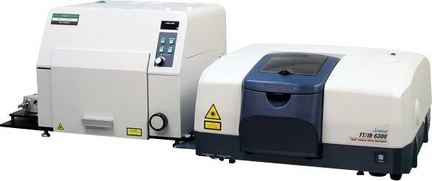
Charc. Techniques: Raman Spectroscopy
Collect knowledge about molecular information and crystalline structures. A laser irradiate the sample with monochromatic radiation, with excitations in the UV, visible and near-IR spectral region (785-1064nm). The irradiation generates a Raman spectrum of scattered light.
Sample preparation:
The pyrolized sample is placed in a quartz or glass vessel and then analyzed, no more sample preparation is needed for Raman.

Slide 11
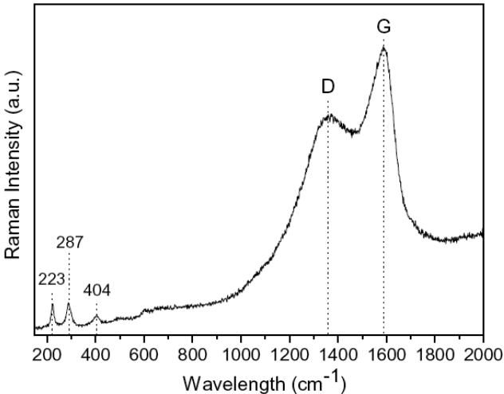
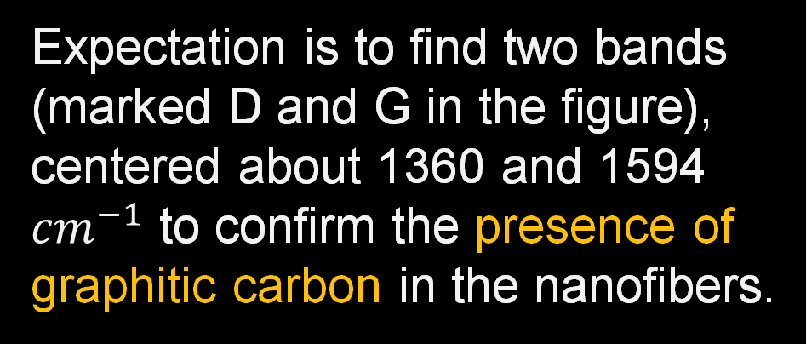
Charc. Techniques: Raman Spectroscopy
Expectation is to find two bands (marked D and G in the figure), centered about 1360 and 1594 ${cm}^{−1}$ to confirm the presence of graphitic carbon in the nanofibers.
C. Eid, A. Brioude, V. Salles, J.-C. Plenet, R. Asmar, Y. Monteil, R. Khoury, A. Khoury, P. Miele, Iron-based 1D nanostructures by electrospinning process, Nanotechnology. 21 (2010) 125701. https://doi.org/10.1088/0957-4484/21/12/125701.

Slide 12
Conclusions:
The presented techniques provide enough data to satisfy the project goal.
Technique | Data obtained
Rheology | Zero-shear viscosity
4-Wire Kelvin | Electrical resistivity
SEM | Fiber morphology
Raman | Presence of graphitic carbon
Rheology ensures electrospinnable polymeric solutions
TGA may provide useful information, but is omitted due to time and availability constraints.
Notes:
*Other techniques* such as TGA may provide useful information, but are omitted due to time and availability constraints.

Slide 13

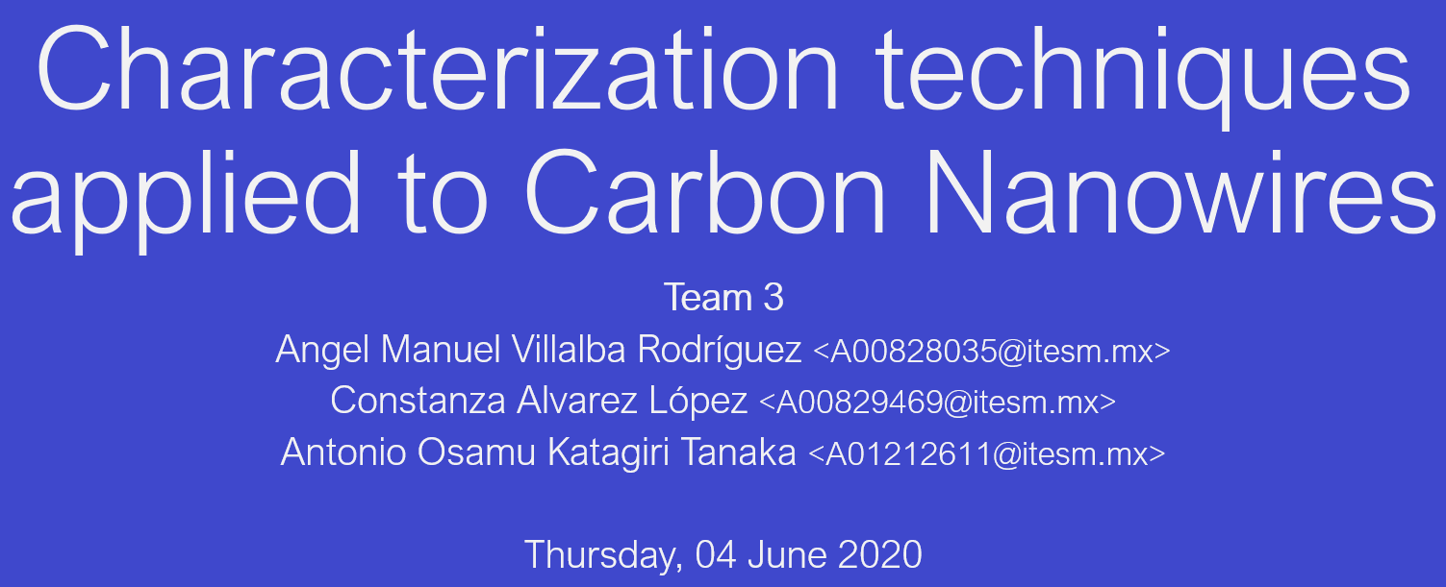

Slide 14
References:
<reference A>
<reference B>

Slide 15
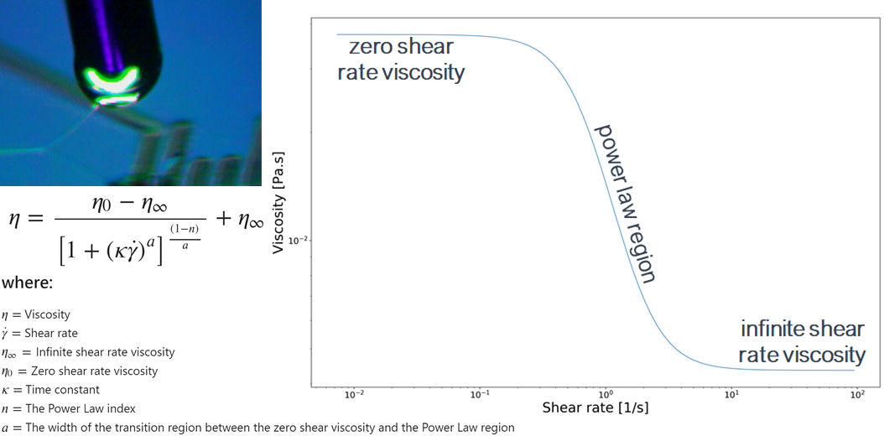
Charc. Techniques: Rheology (Carreau-Yasuda Model)
Osswald, T., Rudolph, N., Osswald, T., & Rudolph, N. (2014). Generalized Newtonian Fluid (GNF) Models. Polymer Rheology, 59–99. https://doi.org/10.3139/9781569905234.003

Slide 16
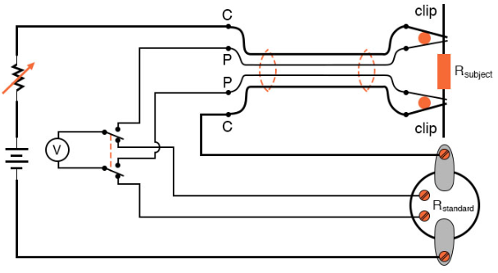


Charc. Techniques: 4-Wire Kelvin
Ohm’s Law:
Electrical conductivity:
$$R=\frac{V}{I} \left[Ω\right]$$
$$σ=\frac{L}{RA} \left[\frac{S}{m}\right]$$

